Slide 1

Cherenkov radiation Prototype

Slide 2
Cherenkov radiation is an electromagnetic radiation emitted when a charged particle (such as an electron) passes through a dielectric medium at a speed greater than the phase velocity of light in that medium.

Slide 3

Procedure:
Cherenkov radiation: enable in PhysicsList
User build detector geometry: Detectorconstruction
“not silent”: assign sensitive detector in detector construction
Feel photons: UserHit class
Collect information：g4root

Slide 4
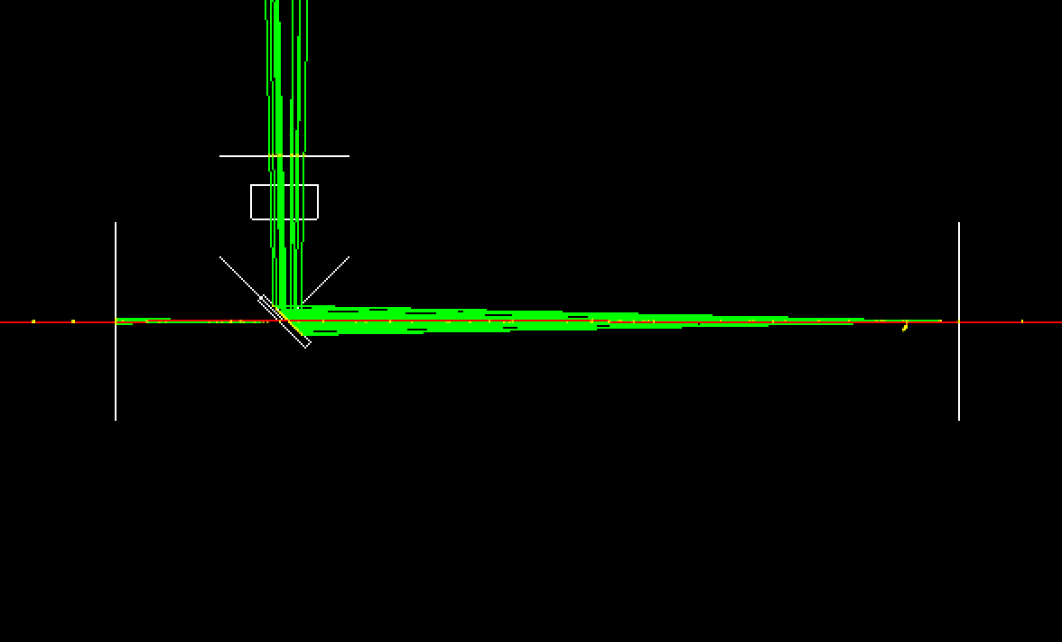

Slide 5
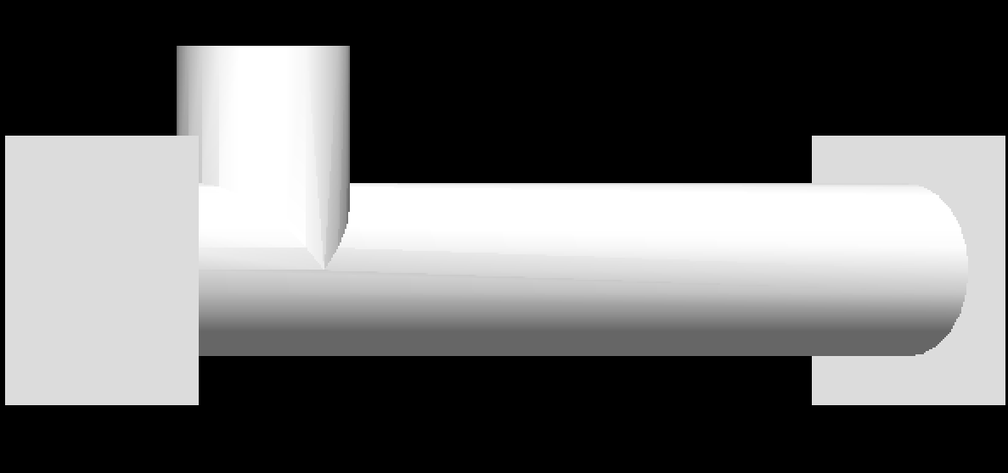

Slide 6
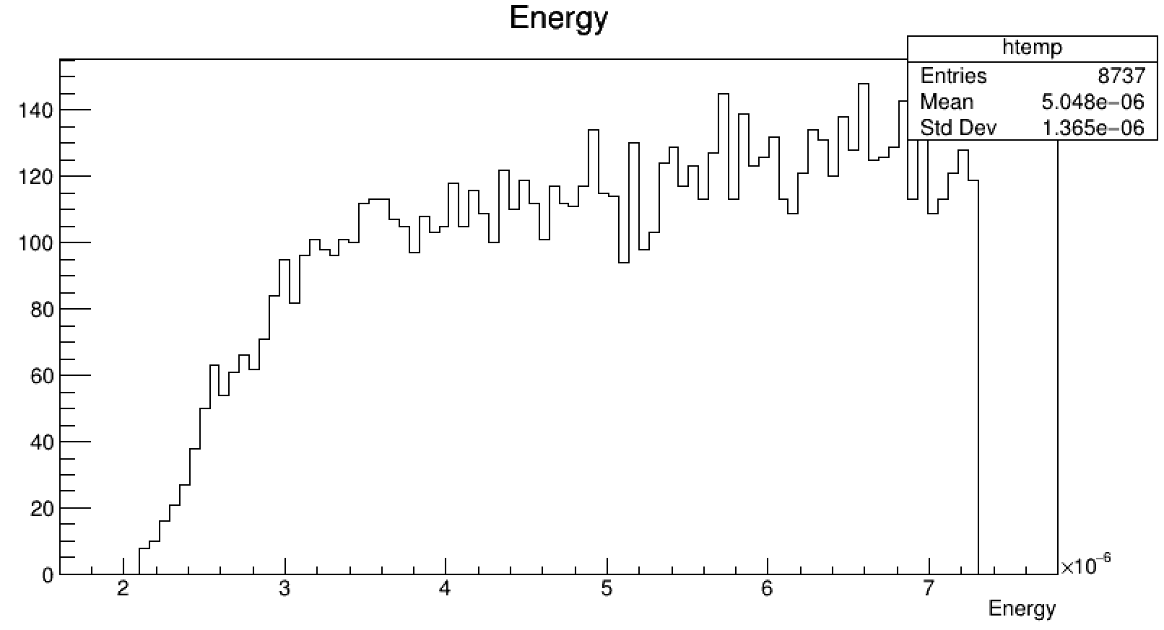
GeV(xaxis unit)

Slide 7
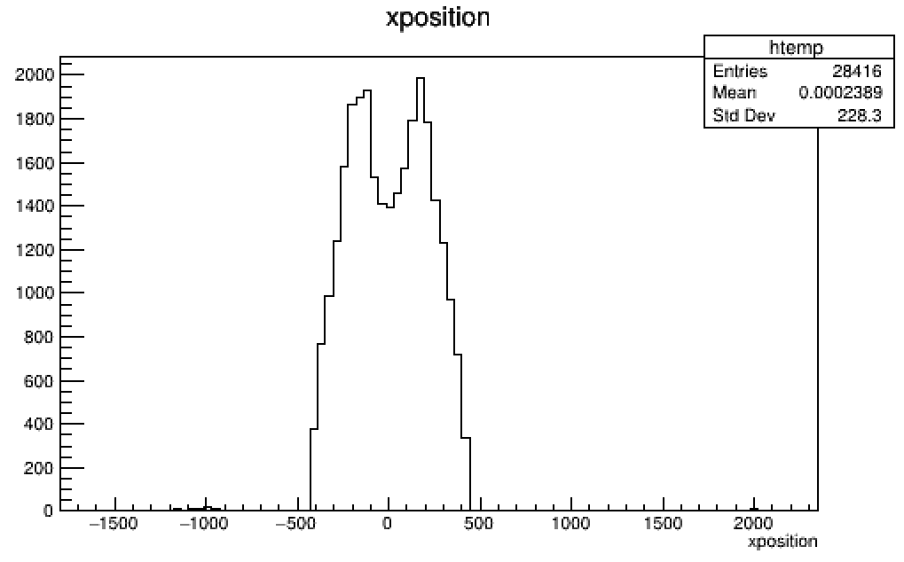
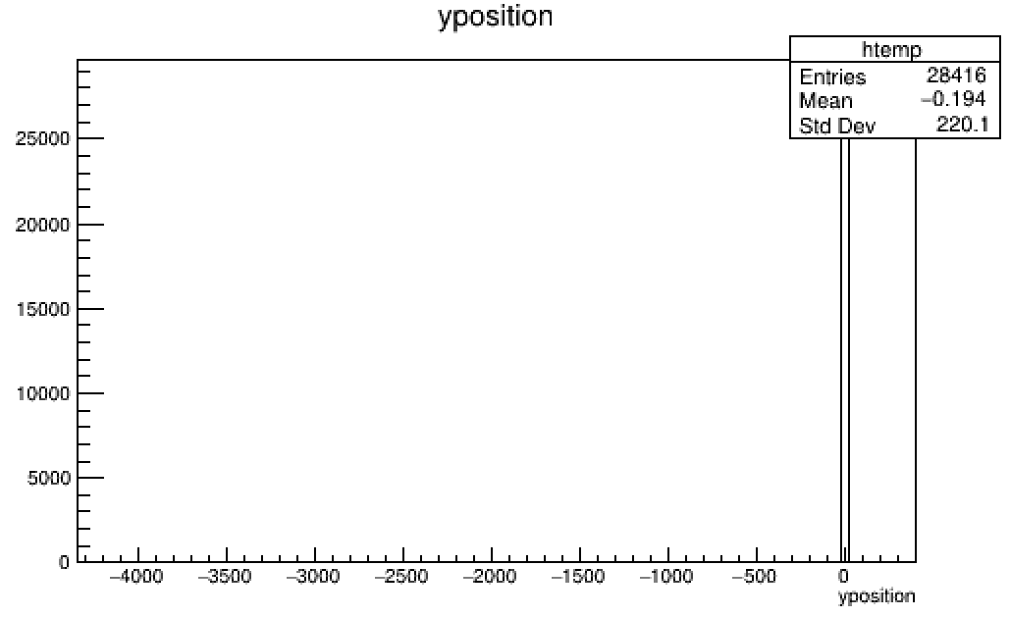
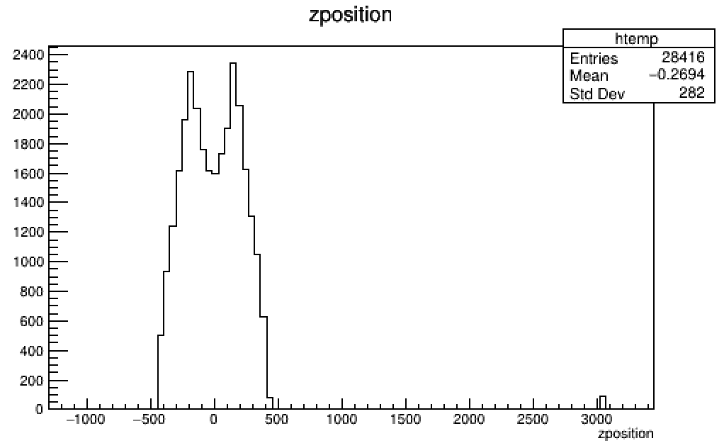

Slide 8
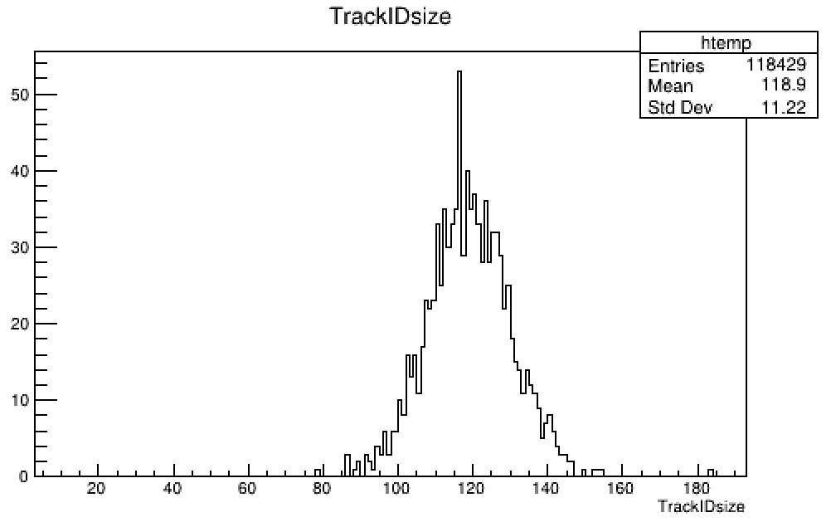
No reflection index
No quantumefficiency

Slide 9
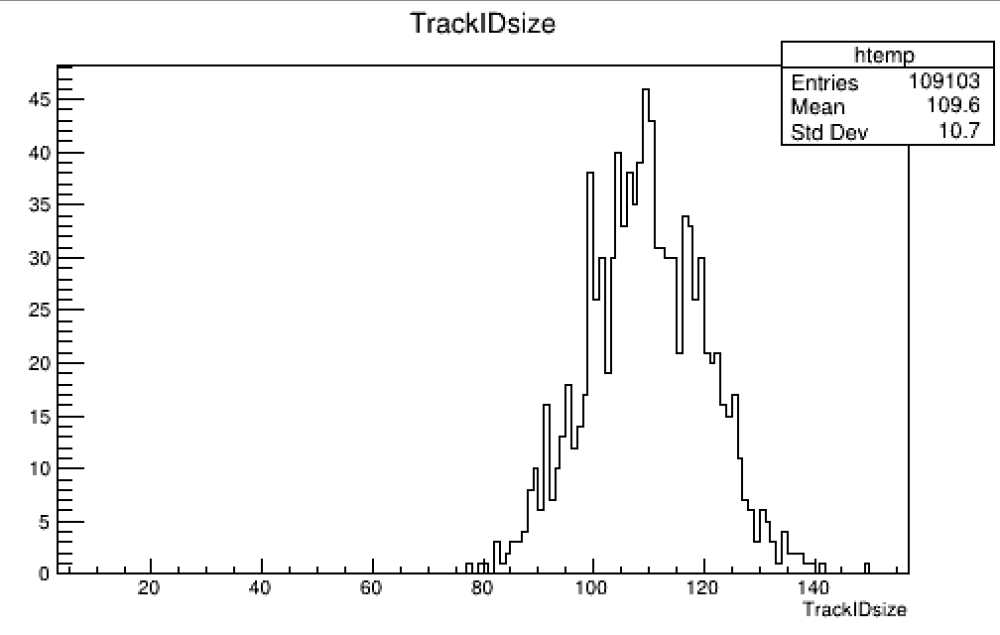
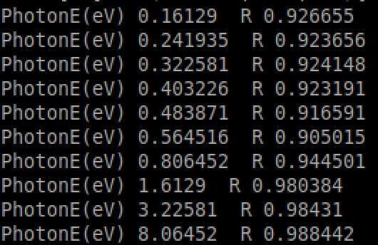
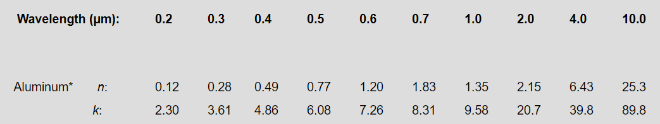
With mirror reflection
No quantum efficiency

Slide 10
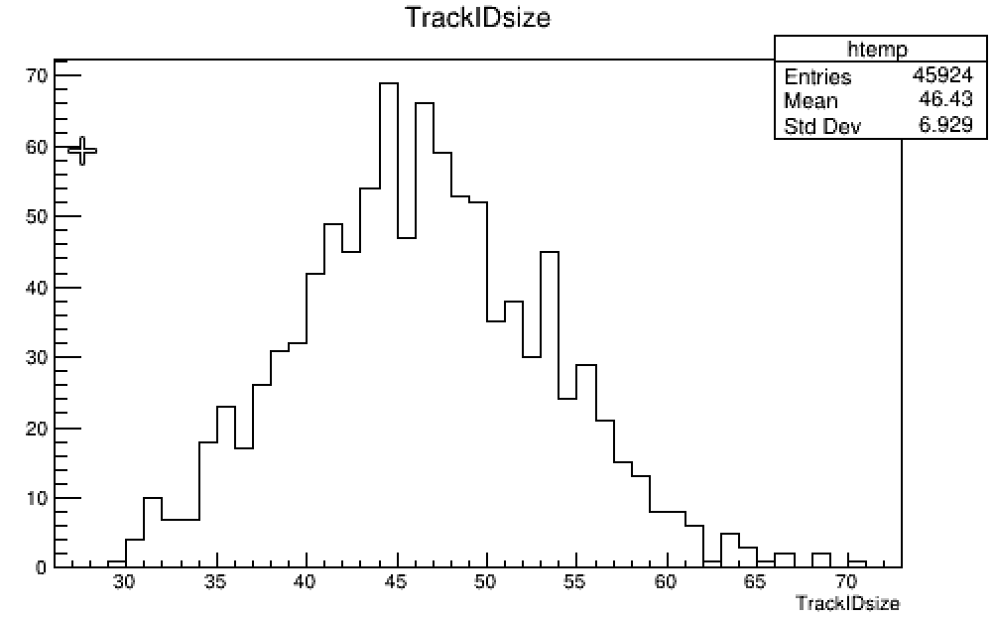
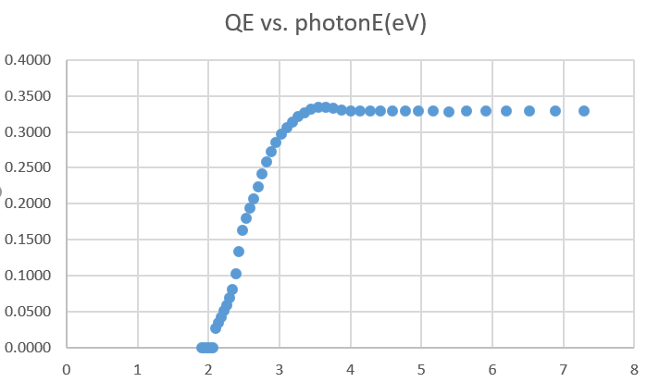
With mirror reflection
With quantum efficiency

